Slide 1
Hezekiah King of Judah
704 - 701 BC
The Biblical Tradition,
Archaeological Discoveries
Epigraphic Evidence
Dr. Robert Deutsch
MARBURG 2022
Notes:
In my first lecture today, I will like to present
2 cases which confirm the historicity of the biblical tradition
in the time of Hezekiah, the son of Ahaz, king of Judah.
Hezekiah ruled in Jerusalem between ca 715 – 687 BC.
and coexisted the great Assyrian Empire

Slide 2
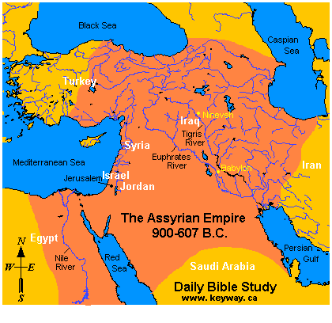
Sennacherib king of Assyria in Nineveh
Notes:
This is a map showing the Assyrian Empire between 900 – 607 BC
The Assyrians, with their capital at Nineveh, spread out from
the Black and the Caspian sea in the North,
The Red sea and the Persian Golf in the South
and the Mediterranean sea in the West

Slide 3
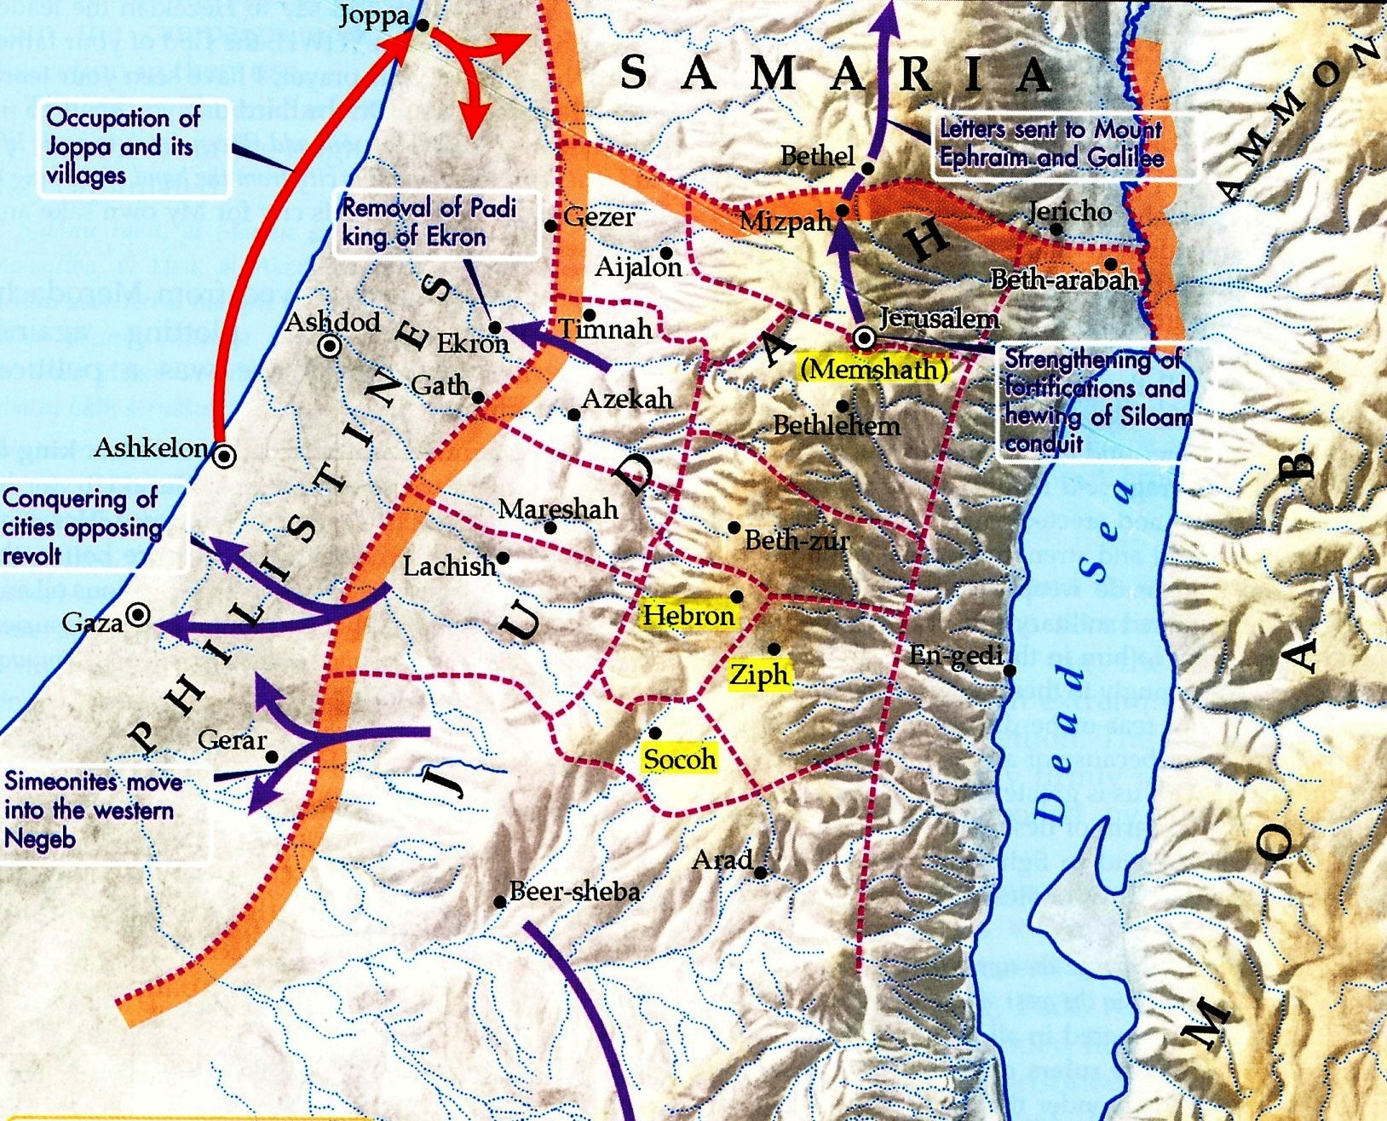
Notes:
Our first topic is the town of Lachish, the most important city in Judah after Jerusalem
Lachish is situated 50 Km South/East from Jerusalem

Slide 4
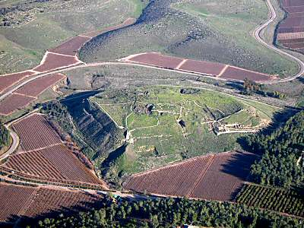
Tell Lachish
Notes:
This is a bird view of the ancient tell. We can see the remains of the
Iron Age fortifications all around, the ramp leading to the city Gate on right and the
large rectangle built platform in the middle, which was the main building in the city, probably the cultic center
Several excavations on the edge of the tell were probes in order to verify the
stratigraphy of the fortifications, because the city was already an important
Canaanite center in the Late Bronze Age, around 15th and 14th cent BCE

Slide 5
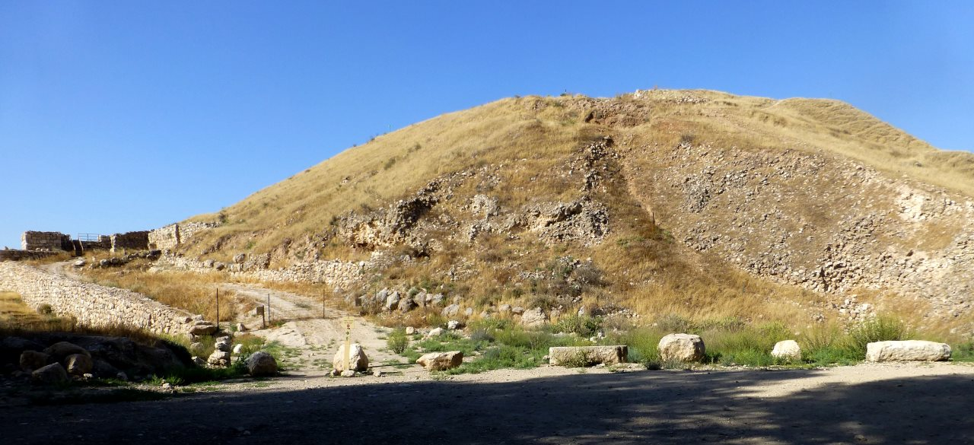
Lachish
Notes:
On the left we see the way leading to the gate of the city
In the middle we can see the remains of the fortifications
This is also the way to walk up to the tell today and to enter through the excavated gate
On to right we can observe a very interesting feature: the siege ramp built by the Assyrians
In order to advance their Siege Machines

Slide 6
The Biblical Tradition
2 Kings - Isaiah - 2 Chronicles
2 Kings 18:13
In the fourteenth year of King Hezekiah, King Sennacherib of Assyria marched against all the fortified towns of Judah and seized them.
Isaiah 36:1
In the fourteenth year of King Hezekiah, King Sennacherib of Assyria marched against all the fortified towns of Judah and seized them.
2 Chronicles 32:1
After these faithful deeds, King Sennacherib of Assyria invaded Judah and encamped against its fortified towns with the aim of taking them over.
Notes:
What information do we have in the
Old Testament regarding The Assyrian invasion into Judah.

Slide 7
The Biblical Tradition
2 Kings - Isaiah - 2 Chronicles
2 Kings 18:21
You rely, of all things, on Egypt, that splintered reed of a staff, which enters and punctures the palm of anyone who leans on it! …
Isaiah 36:6
You are relying on Egypt, that splintered reed of a staff, which enters and punctures the palm of anyone who leans on it. …
2 Chronicles 32:10
Thus said King Sennacherib of Assyria: On what do you trust to enable you to endure a siege in Jerusalem?...

Slide 8
The Biblical Tradition
2 Kings - Isaiah - 2 Chronicles
2 Kings 18:17
But the king of Assyria sent the Tartan, the Rabsaris, and the Rabshakeh from Lachish with a large force to King Hezekiah in Jerusalem ….
Isaiah 36:2
From Lachish, the king of Assyria sent the Rabshakeh, with a large force, to King Hezekiah in Jerusalem
2 Chronicles 32:9
King Sennacherib of Assyria sent his officers to Jerusalem—he and all his staff being at Lachish—with this message to King Hezekiah of Judah and to all the people of Judah who were in Jerusalem:

Slide 9
The Biblical Tradition
2 Kings - Isaiah - 2 Chronicles
2 Kings 19:35-37
³⁵ That night the angel of the Lord went out and put to death 185,000 in the Assyrian camp. When the people got up the next morning - there were all the dead bodies. ³⁶ So Sennacherib king of Assyria departed and returned home… ³⁷ … as he was worshiping in the house of Nisrok his god, that Adrammelech and Sharezer killed him with the sword…
Isaiah 37:36-38
³⁶ Then the angel of the Lord went out and put to death 185,000 in the Assyrian camp. When the people got up the next morning there were all the dead bodies! ³⁷ So Sennacherib king of Assyria broke camp and withdrew … ³⁸ … while he was worshiping in the temple of his god Nisrok, his sons Adrammelech and Sharezer killed him with the sword …
2 Chronicles 32:21
²¹ The Lord sent an angel who annihilated every mighty warrior, commander, and officer in the army of the king of Assyria, and he returned in disgrace to his land. He entered the house of his god, and there some of his own offspring struck him down by the sword.

Slide 10
The Biblical Tradition
2 Kings - Isaiah - 2 Chronicles
The tribute
2 Kings 18:14
… the king of Assyria imposed upon King Hezekiah of Judah a payment of 300 talents of silver and 30 talents of gold. (One Talent = 30 Kg)
Isaiah 36
is ignoring the tribute.
2 Chronicles 32
is ignoring the tribute.

Slide 11
Defending Jerusalem
2 Chronicles 32:2-6
2 When Hezekiah saw that Sennacherib had come, intent on making war against Jerusalem,
3 he consulted with his officers and warriors about stopping the flow of the springs outside the city, and they supported him.
4 A large force was assembled to stop up all the springs and the stream that flowed through the land, for otherwise, they thought, the king of Assyria would come and find water in abundance.
5 He acted with vigor, rebuilding the damaged wall, raising towers on it, and building another wall outside it. He fortified the Millo of the City of David, and made a great quantity of arms and shields.
6 He appointed battle officers over the people ….
Notes:
What information do we have regarding the defense of Jerusalem?

Slide 12
The Epigraphic Evidence
The Annals of Sennacherib King of Assyria

Slide 13
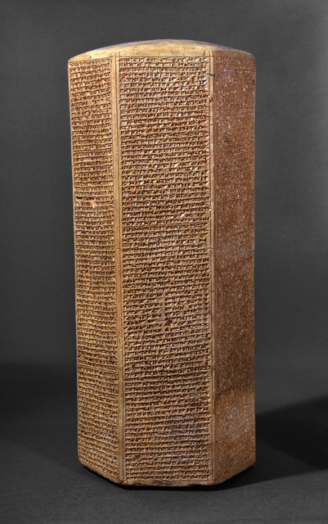
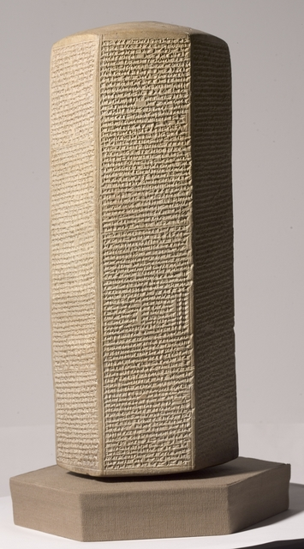
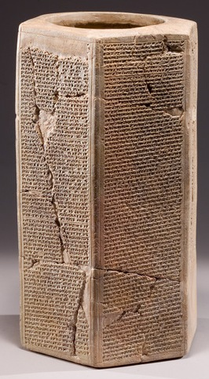
The Sennacherib Prisms
Israel Museum, Jerusalem British Museum Oriental Institute, Chicago

Slide 14
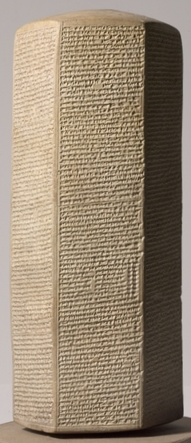
….. As for Hezekiah the Judahite who had not submitted to my yoke, I surrounded 46 of his strong walled towns, and countless small places around them, and conquered them by means of earth ramps and siege engines, attack by infantry men, mining, breaching, and scaling. 200,150 people of all ranks, men and women, horses, mules, donkeys, camels, cattle and sheep without number I brought out and counted as spoil. Himself I made prisoner in Jerusalem, his royal residence, like a bird in a cage. I put watch-posts around him, and made it impossible for anyone to escape from his city. The cities which I had despoiled I cut off from his territory and gave to Mitinti king of Ashdod, Padi king of Ekron, and Sil-Bel king of Gaza, so reducing his realm. I added to their previous annual tax a tribute suitable my lordship, and imposed it on them. Now the fear of my lordly splendor overwhelmed that Hezekiah. The warriors and select troops he had brought in to strengthen his royal city, Jerusalem, did not fight. He had brought after me to Nineveh, my royal city, 30 talents of gold, 800 talents of silver, best antimony, large blocks of carnelian, ivory-decorated beds, ivory-decorated chairs, elephant hides, tusks, ebony, box-wood, valuable treasures of every sort, and his daughters, women of his palace, men and women singers. He sent his personal messenger to pay tribute .......
The Sennacherib Prism
Oriental institute, Chicago
Notes:
Sennacherib added to the previous annual tax, a tribute

Slide 15
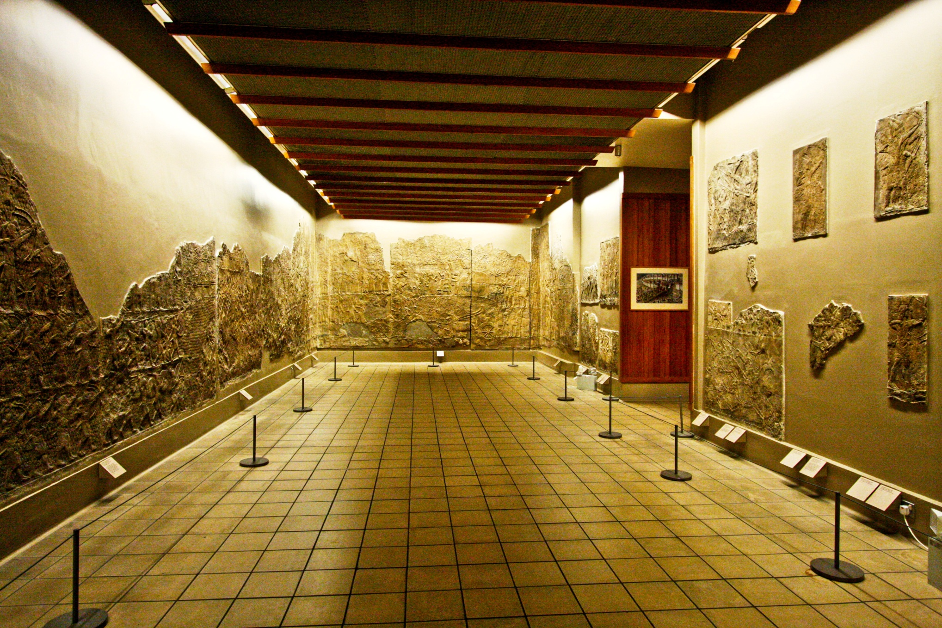
The Lachish room of Nineveh. now in the British Museum
British Museum

Slide 16
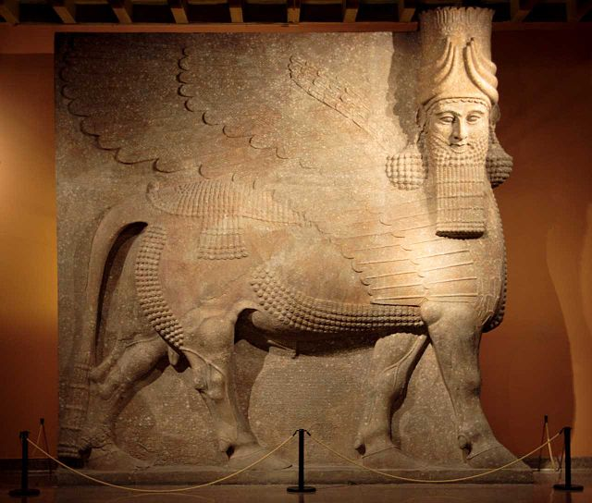
The inscription reads:
“I laid my yoke on Hezekiah the king”.
British Museum

Slide 17
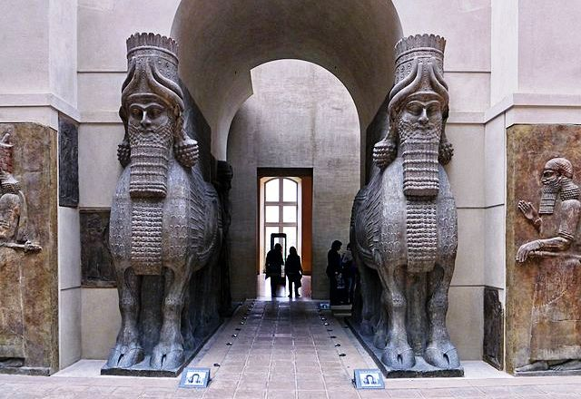
The inscription reads:
“I overthrew the wide region of Judah; its king, Hezekiah, a proud rebel, I made submit at my feet”
Louvre, Paris

Slide 18
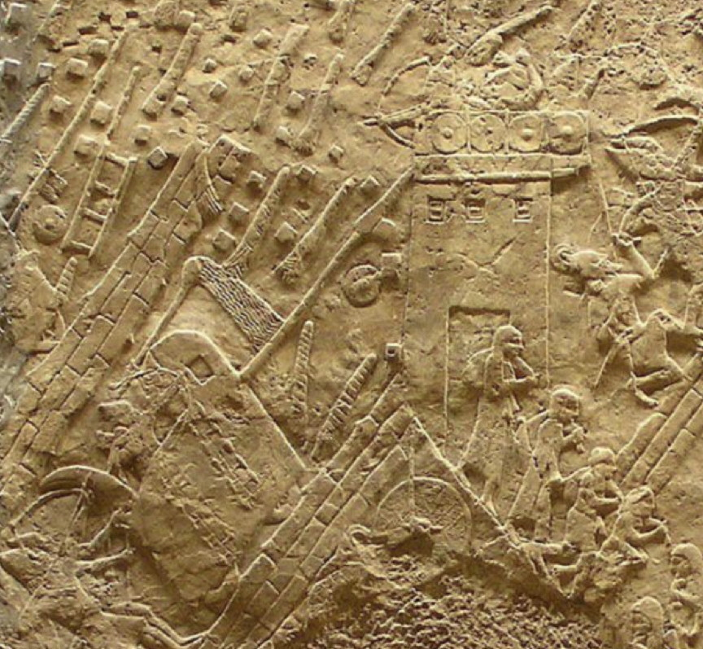
Lachish under the Assyrian Attack
British Museum
Notes:
The narrative is to be viewed from left to right

Slide 19
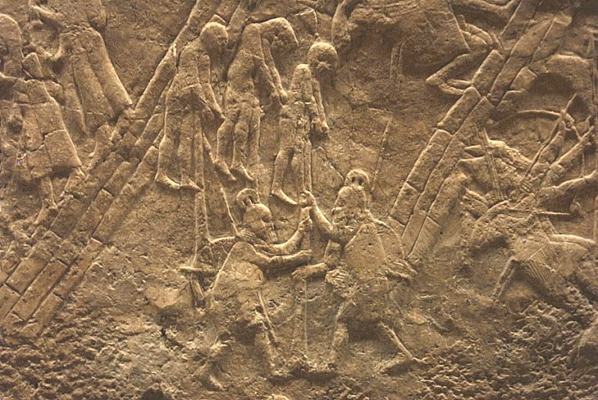
Punishment of the Jewish rebellions
British Museum

Slide 20
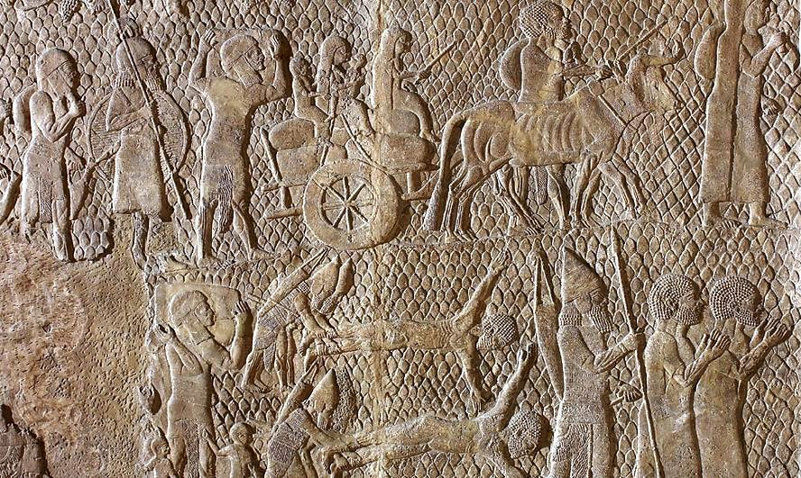
Lachish – Jewish families to exile
British Museum

Slide 21
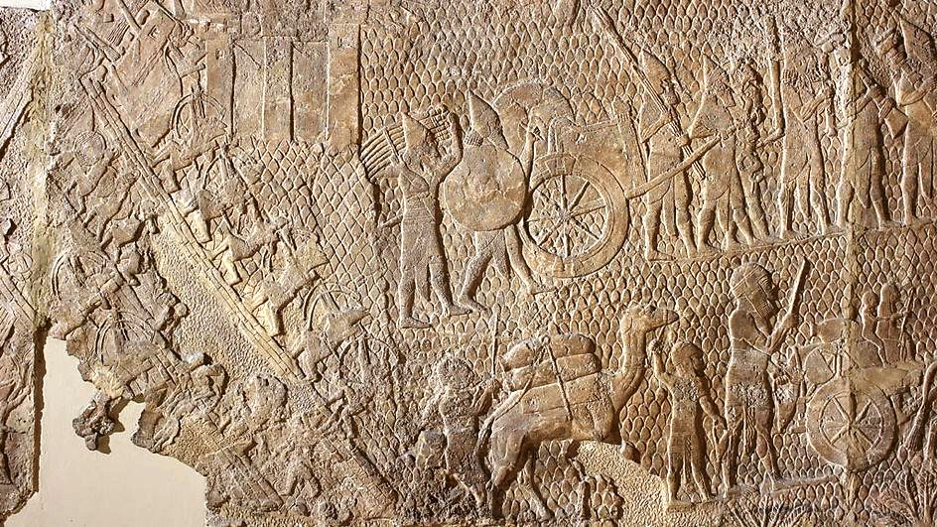
The spoils of Lachish
British Museum

Slide 22
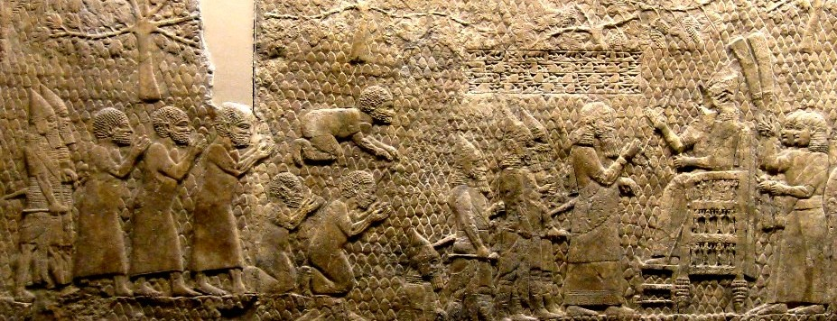
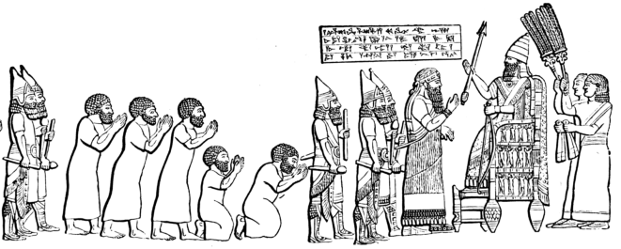
King Sennacherib, seated on the throne, as the ruler of
Lachish is standing before him and the citizens bow down to him.
British Museum

Slide 23
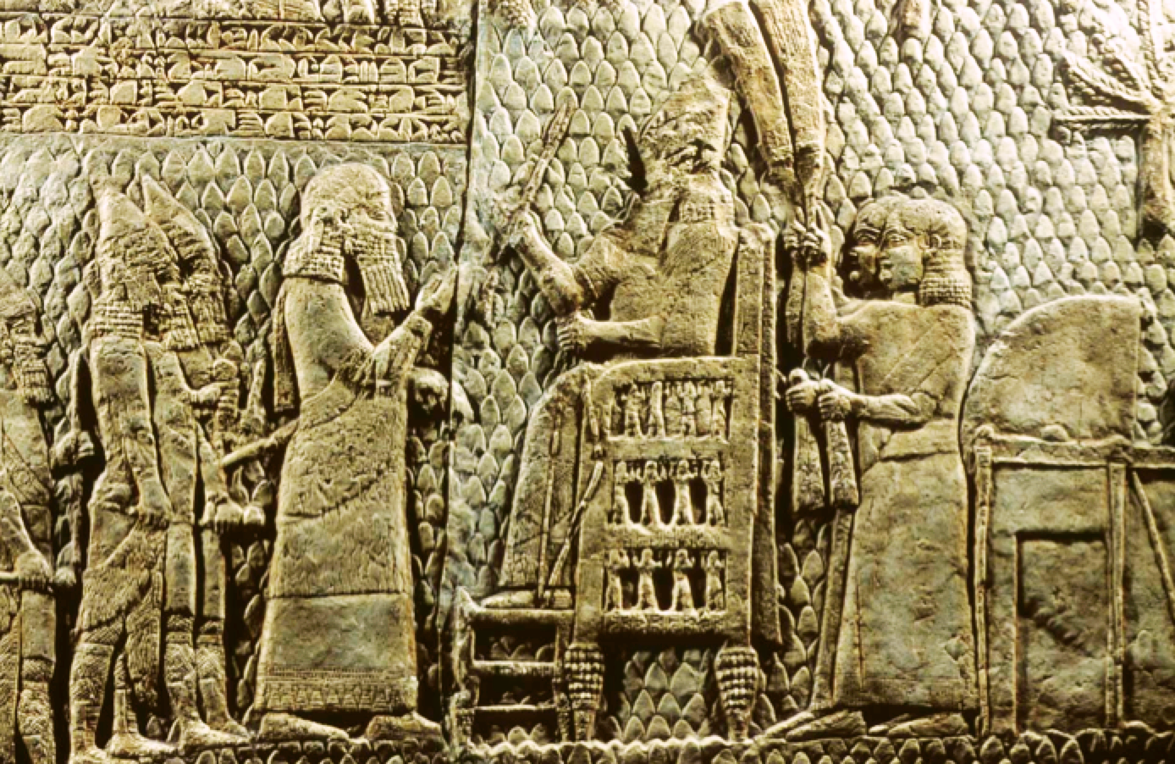
“Sennacherib, king of the world, king of
Assyria, sat on his portable-throne and
the booty of Lachish passed before him”
British Museum
Notes:
The cuneiform inscription reads:
“Sennacherib, king of the world, king of
Assyria, sat on his portable-throne and
the booty of Lachish passed before him”
We can see that at some point in time, someone damaged his face

Slide 24
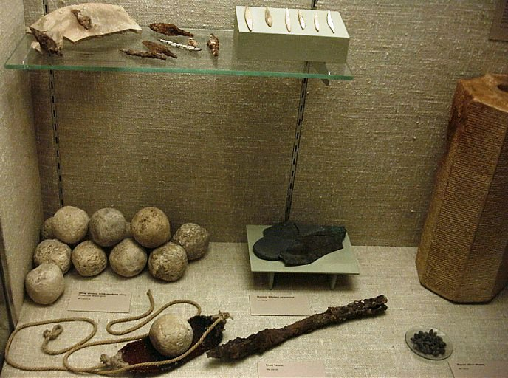
Lachish
British Museum, London
Notes:
The British Expedition at Lachish discovered weapons
Used by the Assyrians in the battle.
Iron and bone arrowheads. Stone sling bullets, Bronze horse blinker, iron spear head

Slide 25
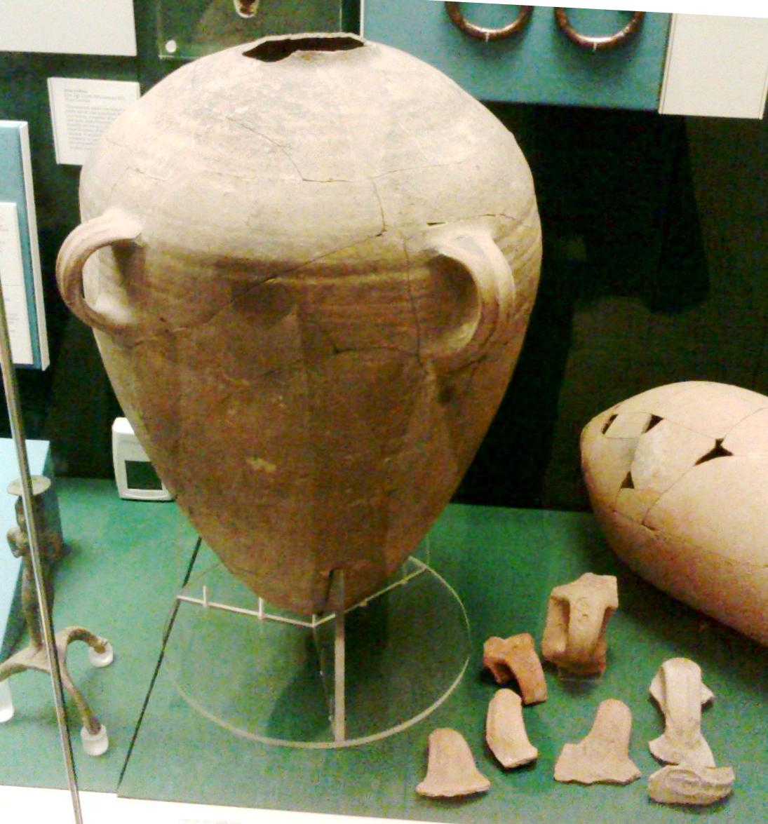
Royal storage jars from Lachish British Museum
Notes:
Also at the British Museum are displayed
Storage jars which are typical Judahites
This particular jar is a prototype of the Fiscal container,
usually having on the handle a seal impression,
which was made before firing.
That means, the jar was manufactured from a it is

Slide 26
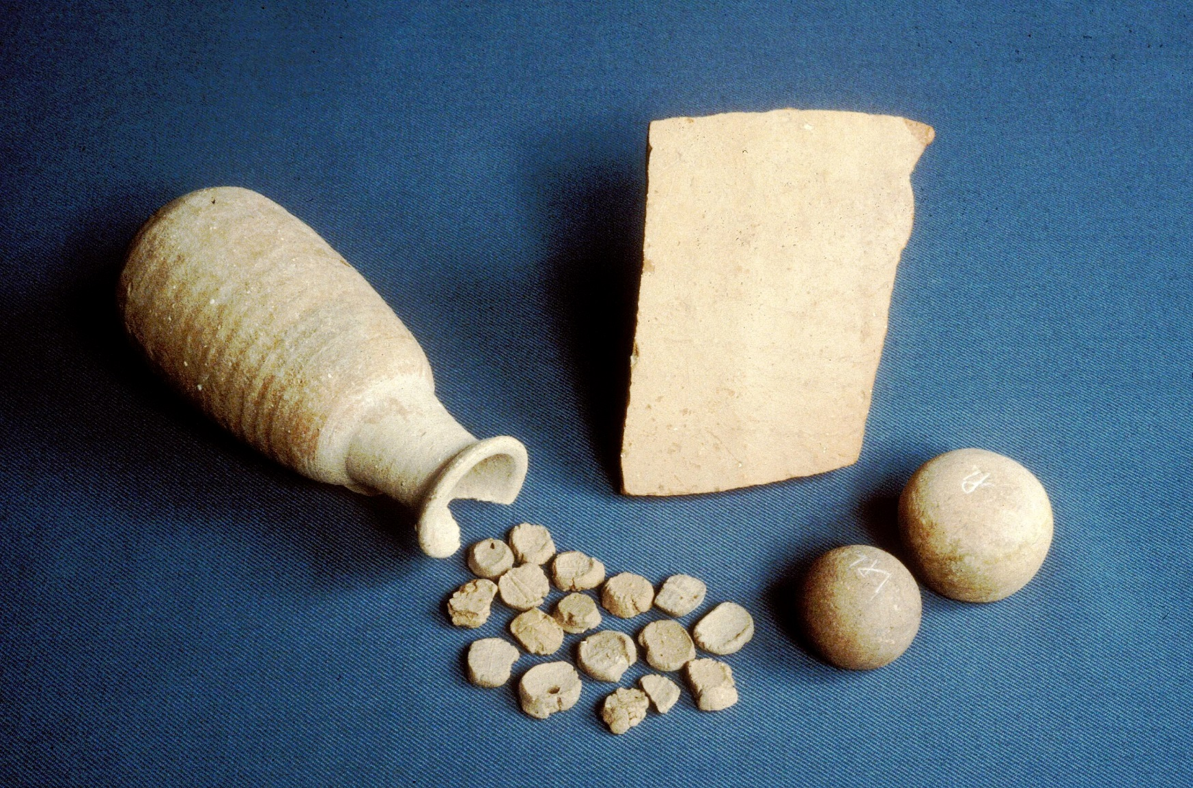
Lachish in the BM
2 Kings 20:20
Notes:
Finds from the gate room of Lachish:
Ostracon, 2 stone weights, ceramic juglet which contains 17 clay bullae (seal impressions)

Slide 27
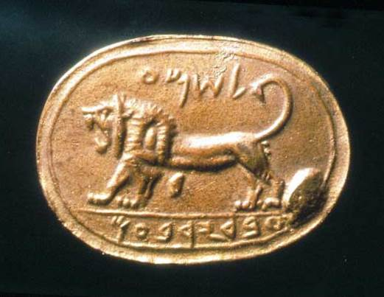
Megiddo
Belonging to Shema
Servant of Jeroboam

Slide 28
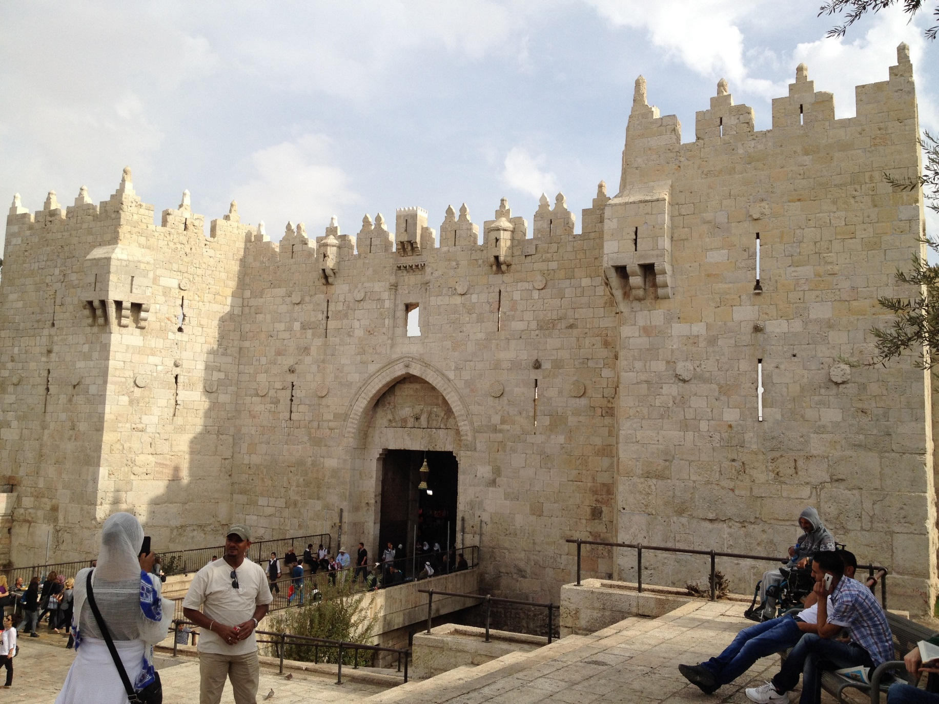
JERUSALEM

Slide 29
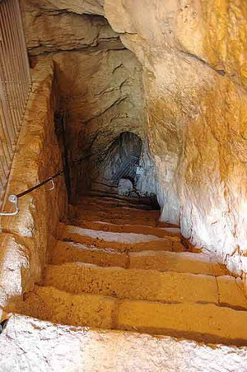
The Archaeological Evidence
The Siloam Tunnel
And the rest of the acts of Hezekiah and all his might, and how he made the pool, and the aqueduct, and brought water into the city, are they not written in the book of the chronicles of the kings of Judah?
2 Kings 20:20
Notes:
We see here the large, and high entrance (with the modern stairs) and the beginning of the tunnel.
It is carved in solid stone and we can observe large horizontal cracks

Slide 30
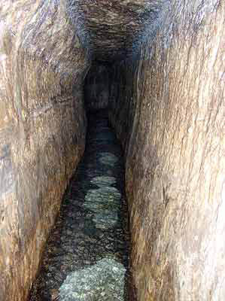
The Archaeological Evidence
The Siloam Tunnel
And the rest of the acts of Hezekiah and all his might, and how he made the pool, and the aqueduct, and brought water into the city, are they not written in the book of the chronicles of the kings of Judah?
2 Kings 20:20
Notes:
The tunnel which leads the waters, still seen today

Slide 31
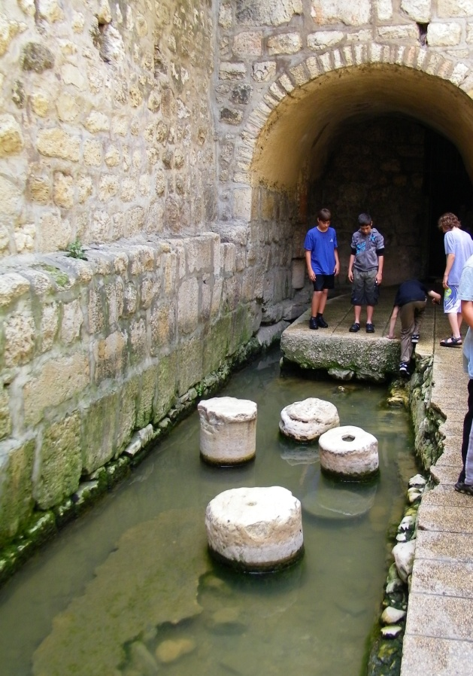
The Siloam Tunnel
And the rest of the acts of Hezekiah and all his might, and how he made the pool, and the aqueduct, and brought water into the city, are they not written in the book of the chronicles of the kings of Judah?
2 Kings 20:20
Notes:
The pool in the city

Slide 32
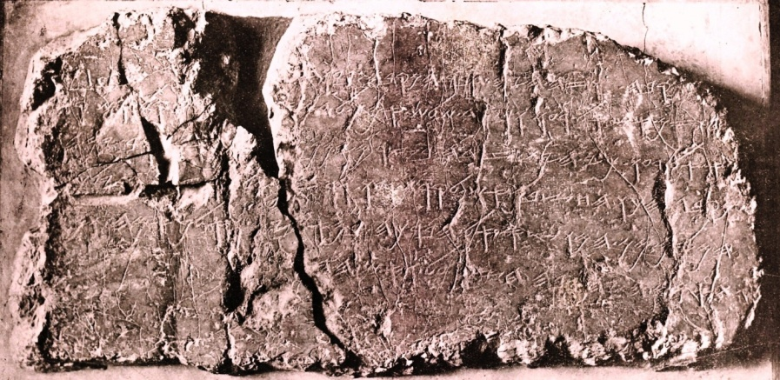
The Siloam Tunnel Inscription
Today in Istambul Museum
Notes:
I will like to end this first part of my presentation with a question,
Why and for which porpoise did the inscription was engraved in the middle of
The tunnel, the tunnel in which no one enters, there is no walking in it to see it,
There is no “Spaziergang” in the darkness of the tunnel, there is no light there, and no one can see it
This is also the reason why the inscription was discovered only in 1838 by Edward Robinson.

Slide 33
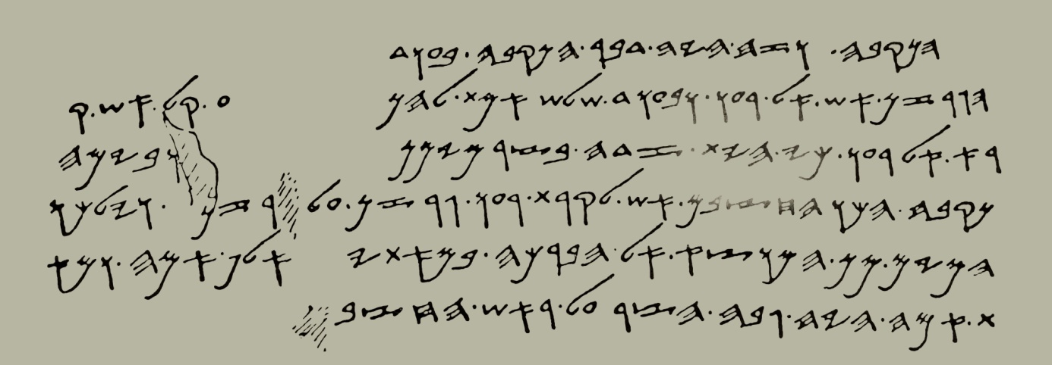
The Archaeological Evidence
Istanbul Museum

Slide 34
The Archaeological Evidence
The Siloam Tunnel
2 Kings 20:20
And the rest of the acts of Hezekiah and all his might, and how he made the pool, and the aqueduct, and brought water into the city, are they not written in the book of the chronicles of the kings of Judah?
Notes:
The Biblical narrative

Slide 35
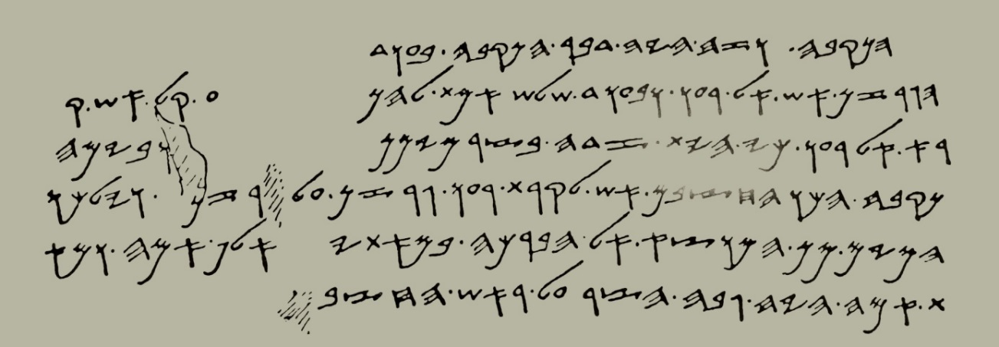
1. The tunnel. And this is the account of the tunneling. When . . .
2. the pickaxes one against the other. And when there were only three cubits more to cut (through, the men were) heard
3. calling from one side to the other; [for] there was a crack in the rock, on the right and on the left side, and on the day of the
4. piercing the workmen struck each to meet the other, pickax against pickax. And there flowed
5. the waters from the spring to the pool 1,200 cubits. And 100
6. cubits was the height over the head of the workmen.
Notes:
The translation of the Siloam inscription

Slide 36
1. The tunnel. And this is the account of the tunneling. When . . .
2. the pickaxes one against the other. And when there were only three cubits more to cut (through, the men were) heard
3. calling from one side to the other; [for] there was a crack in the rock, on the right and on the left side, and on the day of the
4. piercing the workmen struck each to meet the other, pickax against pickax. And there flowed
5. the waters from the spring to the pool 1,200 cubits. And 100
6. cubits was the height over the head of the workmen (cubit = 40 cm)
THE INFORMATION PROVIDED
The length of the tunnel 1,200 cubits (480 meters)
The depth 100 cubits (40 meters)
The pathway of the tunnel - along a crack in the rock
The purpose of the tunnel - to lead the waters of the spring to a pool (inside the town)
YET, THE MOST IMPORTANT INFORMATION IS MISSING
Notes:
We can figure out that the inscription has been engraved by the workmen
But, no monarch or date are mentioned!!

Slide 37
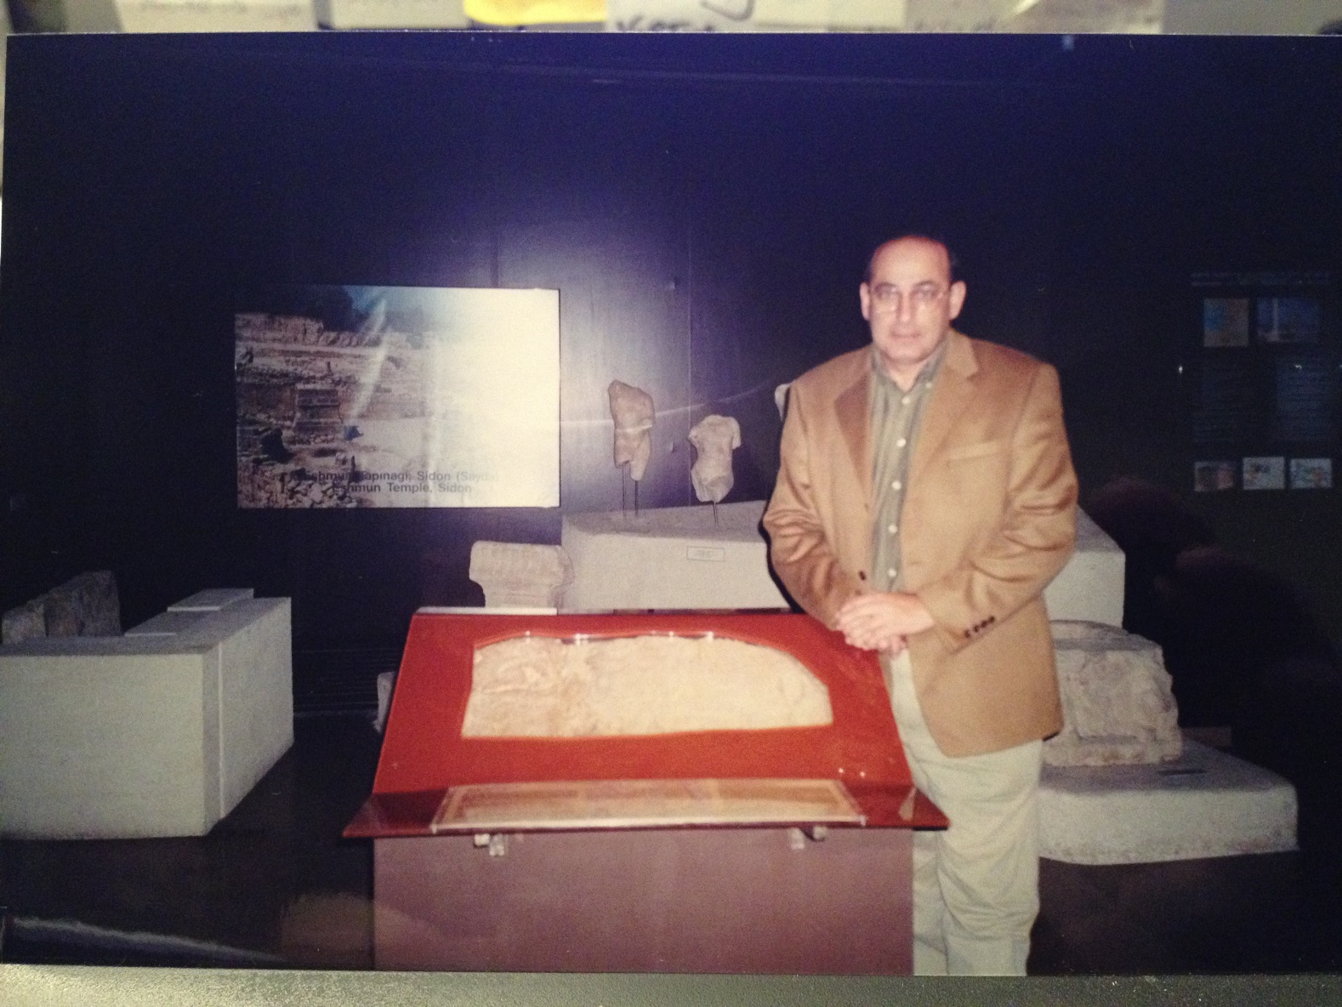
Standing by the Siloam inscription at the Istanbul Museum
Notes:
Thank you for your attention

