Slide 1
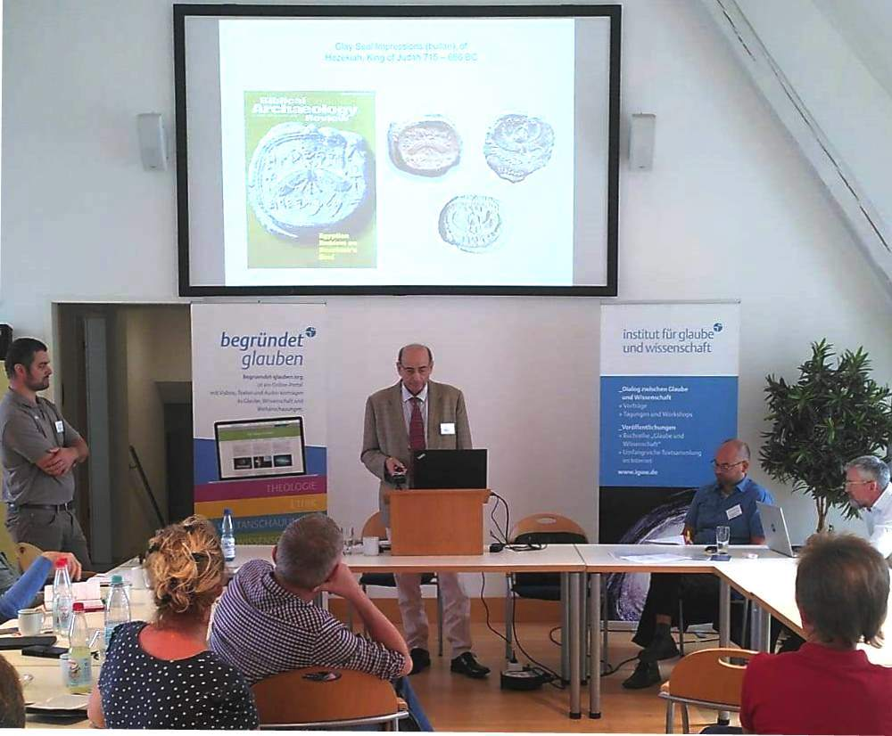
Hezekiah King of Judah
715 - 686 BCE
Archaeology and Epigraphy
Dr. Robert Deutsch

Slide 2
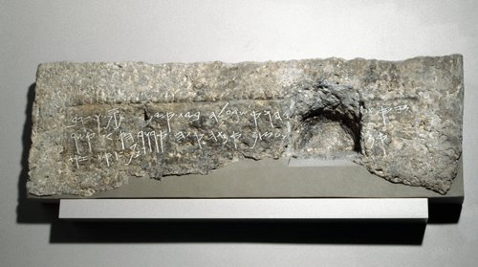
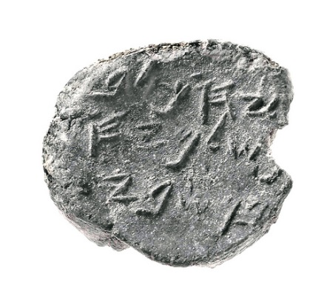
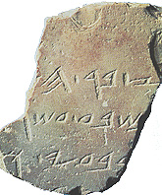
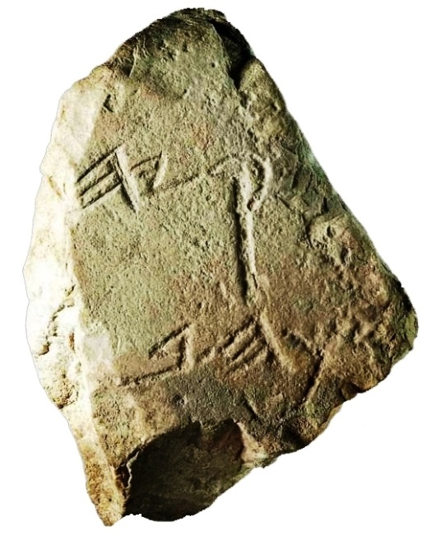
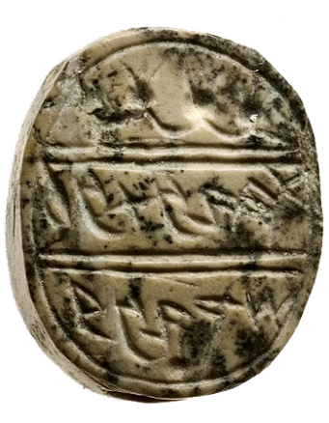
CITY OF DAVID AND SILOAM
JERUSALEM
Notes:
Inscriptions from Jerusalem, ca. 700 BCE
Seals, Seal impression, funerary

Slide 3
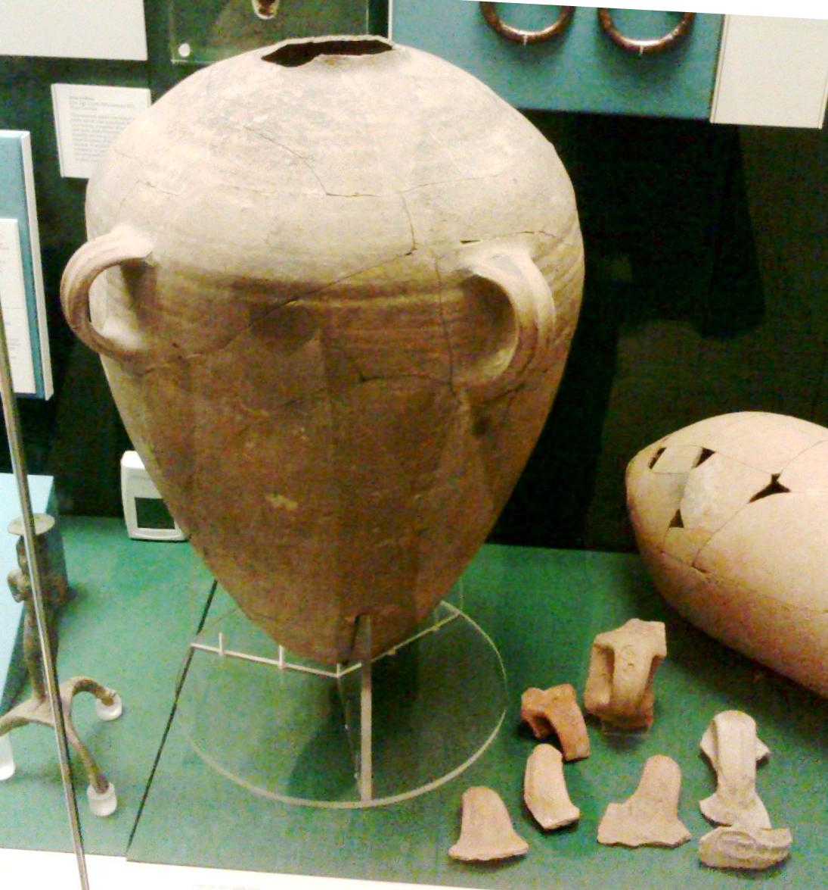
Royal storage jars from Lachish British Museum
Notes:
At the British Museum are displayed storage jars which are typical Judahites
This particular jar is a prototype of the Fiscal container,
usually having on the handle a seal impression,
which was made before firing.

Slide 4
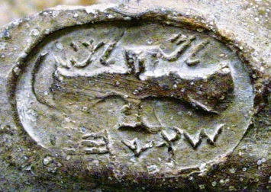
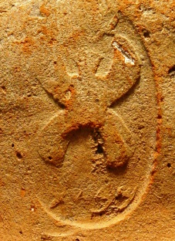
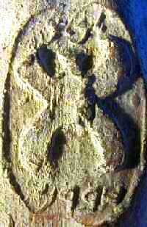
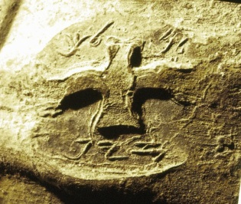
Royal storage jars from Lachish British Museum
Notes:
Fiscal terracotta jars of this type are found in every city in Judah,
usually having on the handles seal impressions
decorated with winged scarabs and winged solar discs

Slide 5
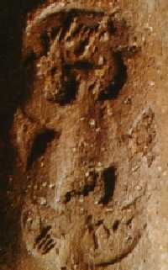
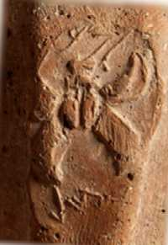
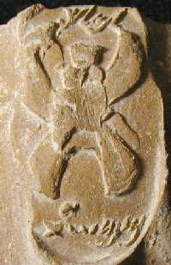
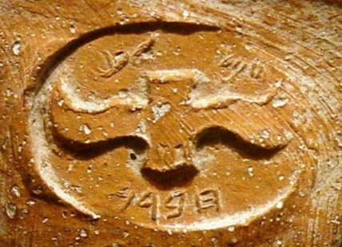
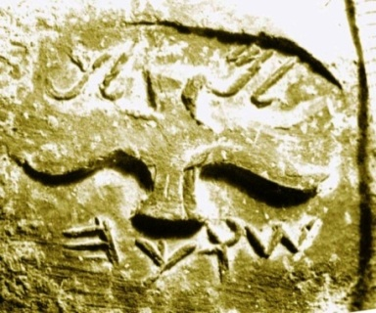
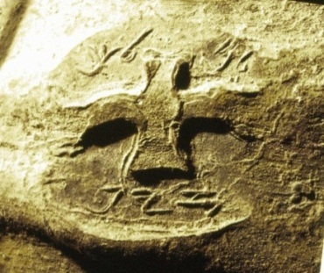
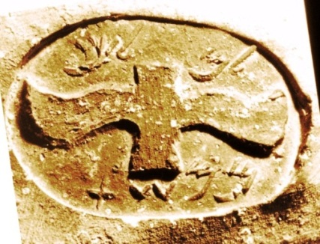
The Royal LMLK seal impression on storage jar handles, ca 700 BCE.
Hebron Socho Zyph Mmshat
ממשת זיף שוכה חברן
Notes:
Bothe emblems, the 4 winged scarab and the 2 winged solar disc,
are used in all 4 locations: Hebron, Socho, Ziph and Mmsht.
We know to locate the first 3 towns but we don’t know a town with the name MMShT
There were attempts to identify MMSht with Jerusalem, but the arguments
Are not convincing.

Slide 6
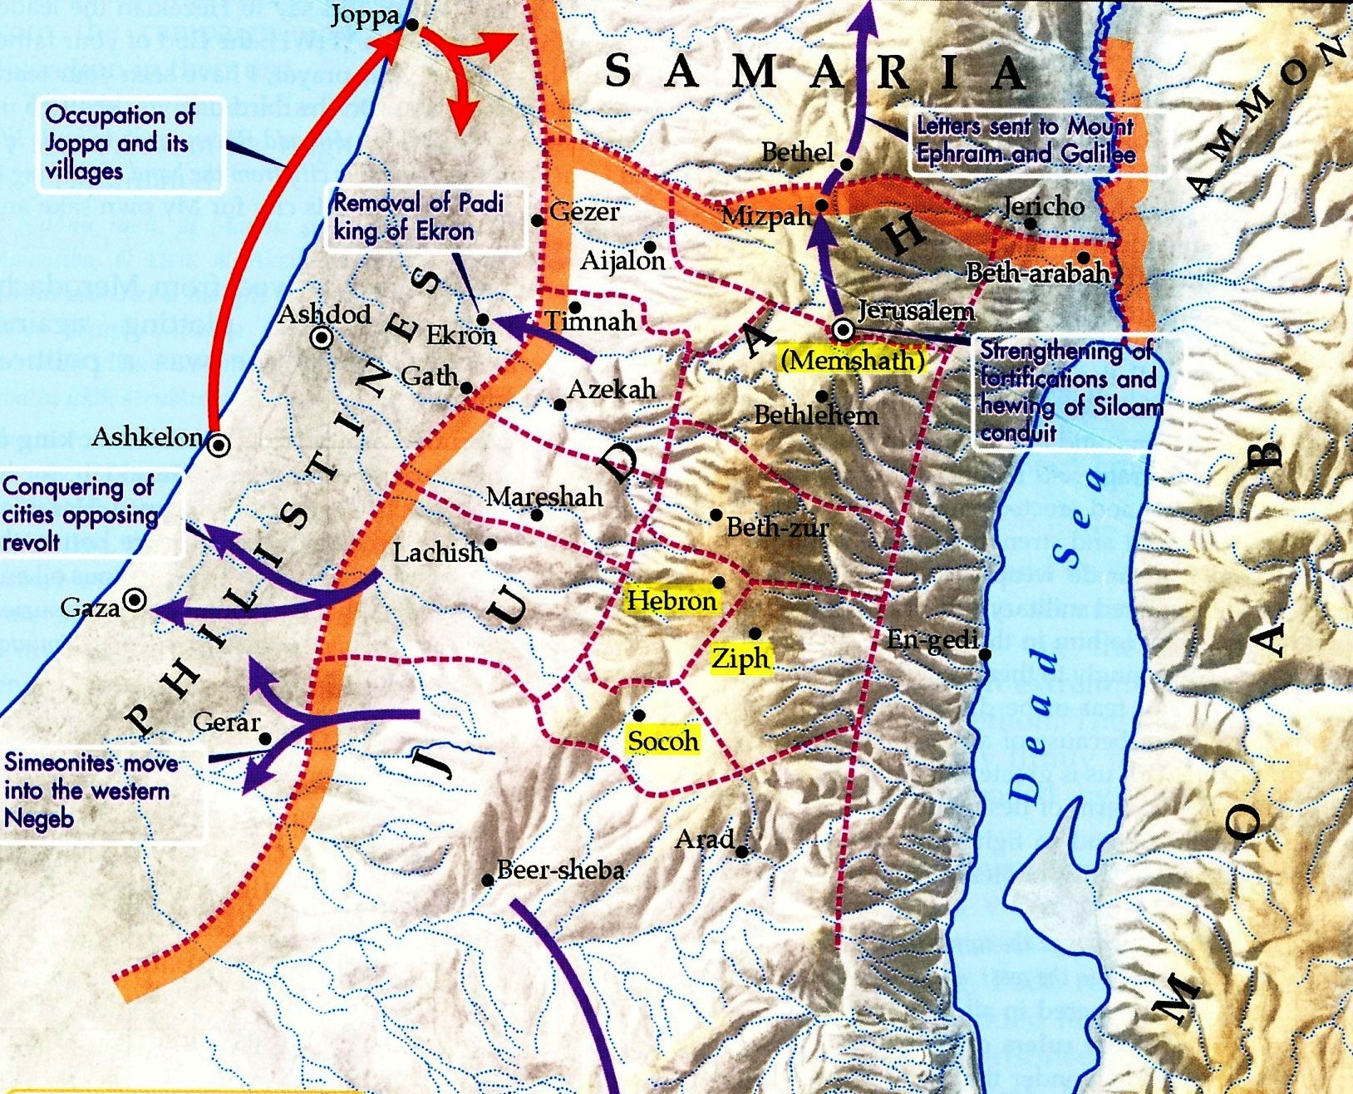
Notes:
The 4 towns mentioned on the seals are:
Mmshat (probably Jerusalem), Hebron, Ziph and Socho,
all 4 located in central Judah

Slide 7
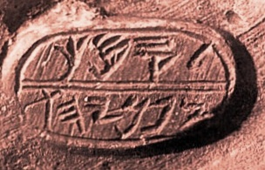
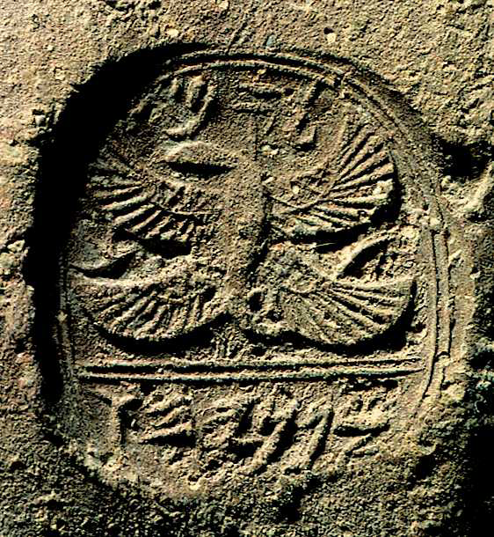
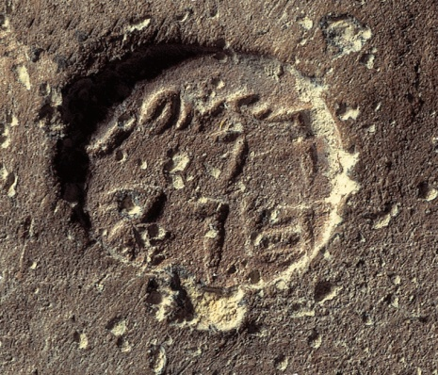
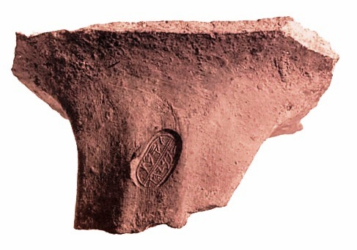
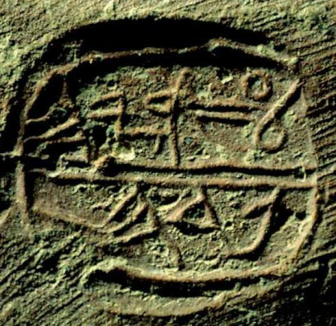
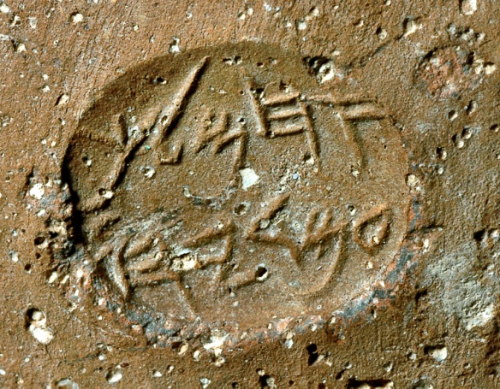
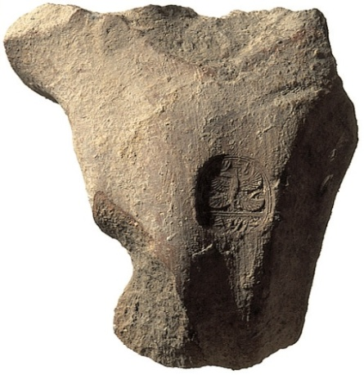
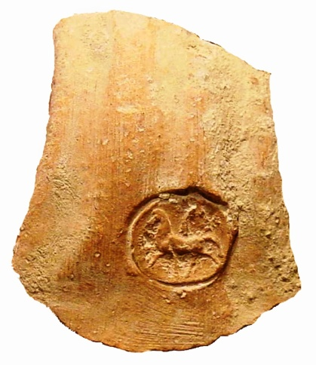
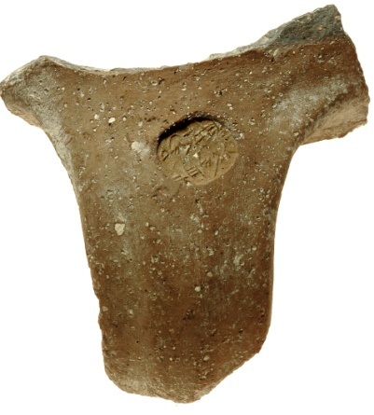
Seal impressions on jar handles, ca 704-701 BCE
Notes:
An additional phenomenon,
which appear simultaneously with the LMLK impressions,
are the so called Private Seals.
This are seals, probably of officials, mentioning a personal name and a patronym, the name of the father.

Slide 8
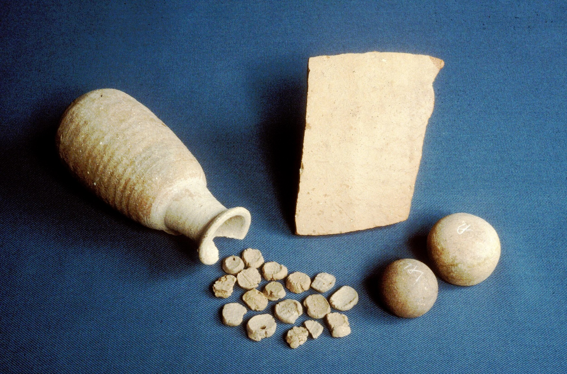
Lachish in the BM
2 Kings 20:20
Notes:
Also at Lachish, in one of the rooms of the gate,
were uncovered seal impressions on bullae
(some of high officials), all found in the juglet,
2 stone shekel weights and a Hebrew ostracon
An ostracon is a sherd of ceramic vessel, used to write on it with ink

Slide 9
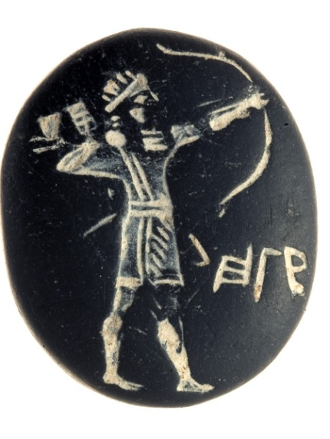
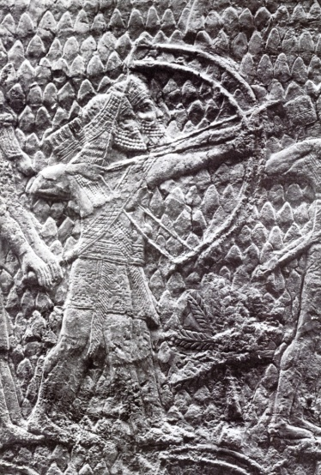
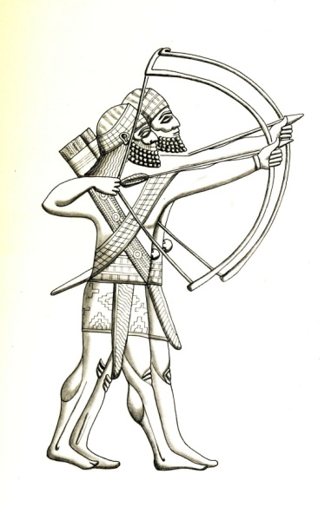
Seal found in Jerusalem The Siege of Lachish, Nineveh
“Belonging to Hagab”
Notes:
This Jewish seal belonging to Hagab,
depicting an Assyrian archer,
has been discovered in Jerusalem

Slide 10
The Biblical Tradition
2 Kings - Isaiah - 2 Chronicles
2 Kings 18:18
… and Eliakim son of Hilkiah, who was in charge of the palace, Shebna the scribe, and Joah son of Asaph the recorder went out to them.
Isaiah 36:3
and Eliakim son of Hilkiah who was in charge of the palace, Shebna the scribe, and Joah son of Asaph the recorder went out to him.
2 Chronicles 32
The high officials are not mentioned.
Notes:
Often, high officials are mentioned in the OT,
High officials which had personal seals (some of them more than one seal)

Slide 11
---------------
HERODOTUS (regarding Babylonians)
I:195. Such are their boats; and the following is the manner of dress which they use, namely a linen tunic reaching to the feet, and over this they put on another of wool, and then a white mantle thrown round, while they have shoes of a native fashion rather like the Boeotian slippers. They wear their hair long and bind their heads round with fillets, and they are anointed over the whole of their body with perfumes. Each man has a seal and a staff carved by hand, and on each staff is carved either an apple or a rose or a lily or an eagle or some other device, for it is not their custom to have a staff without a device upon it.
-----

Slide 12
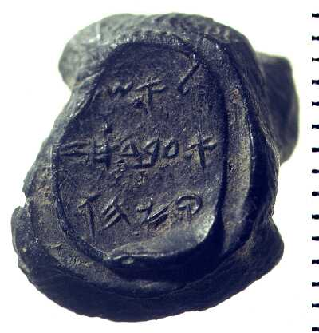
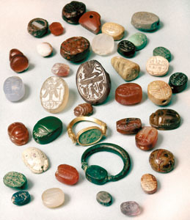
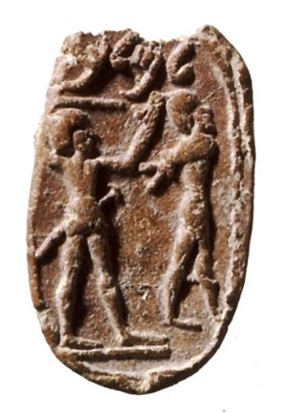
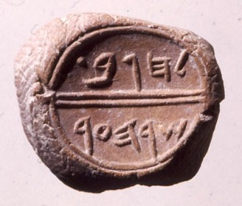
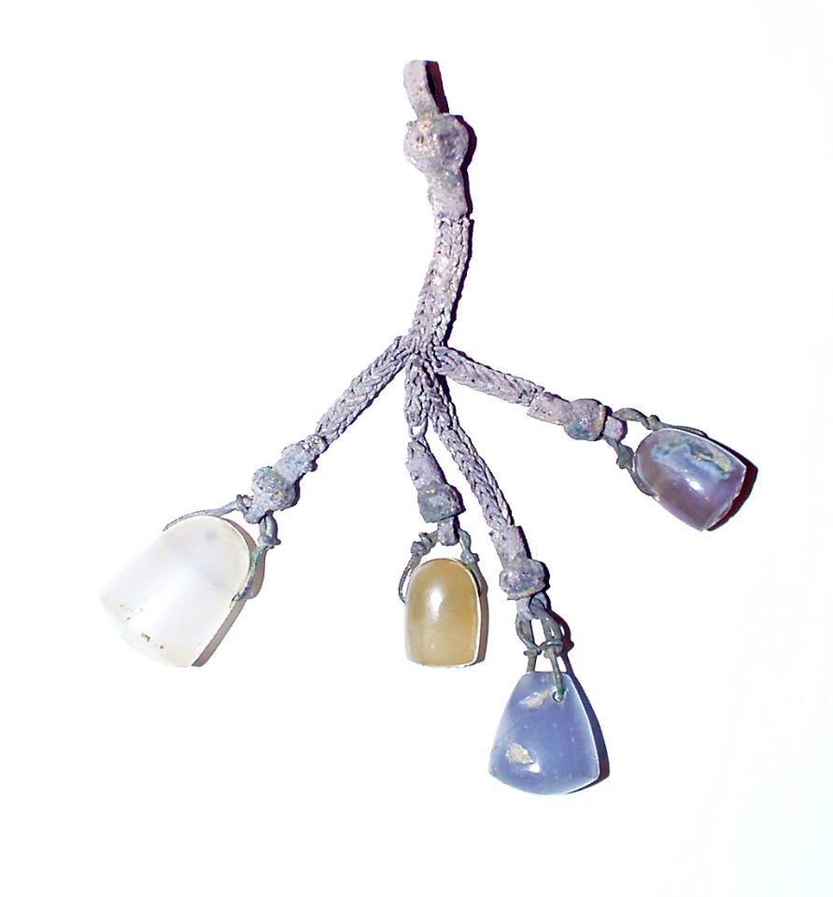
Seals and bullae
Notes:
Seals are found, relatively, in abundance.

Slide 13
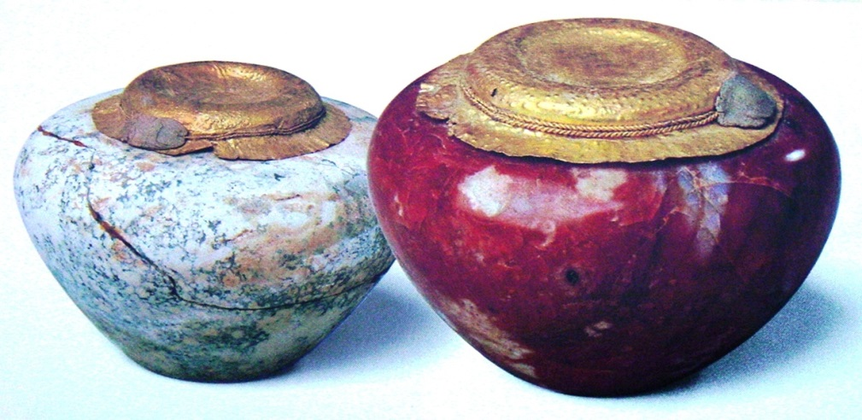
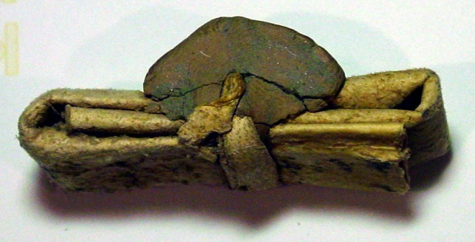
The use of seals
Notes:
3rd millennium Egyptian stone jars covered with gold leaves and sealed with bullae,
a papyrus letter from the Persian Period, 5th cent BCE tied and sealed with a bulla
and a Hellenistic 2nd cent BCE document sealed by 7 bullae
which

Slide 14
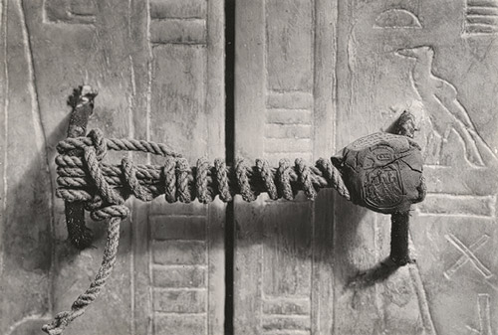
Tutankhamun seal impression on clay bullae
Notes:
The sealed entrance to Tut Anch Amun’s tomb

Slide 15
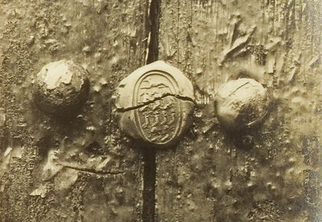
Tutankhamun seal impression on clay bullae
Notes:
A sealed shrine in the Tut Anch Amun’s tomb

Slide 16
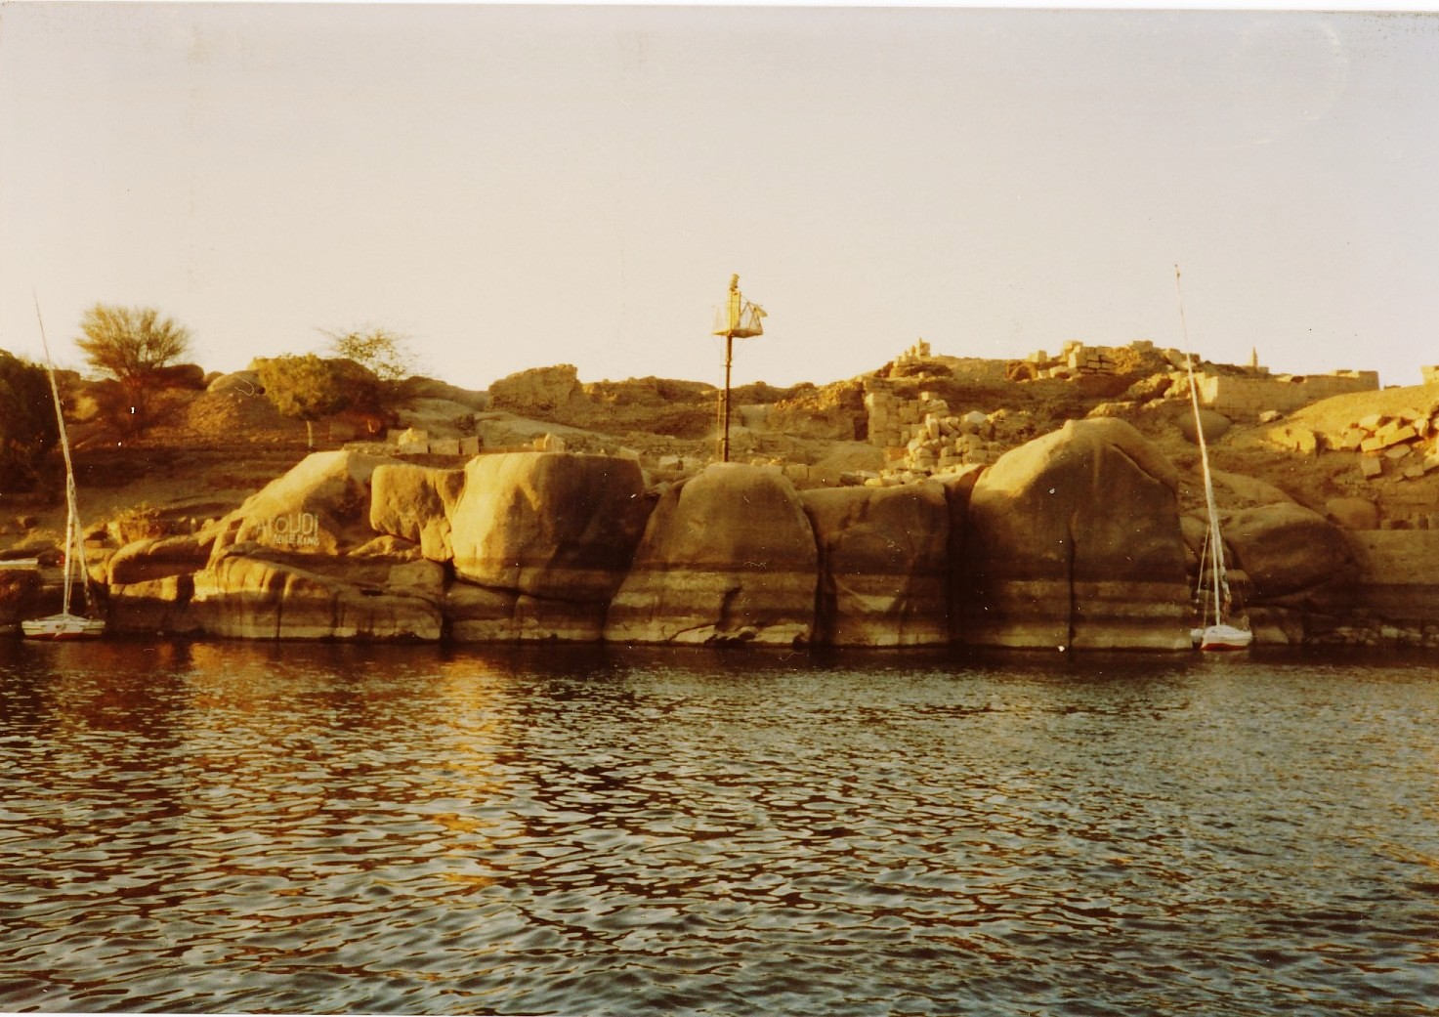
SEALED BOOK
16
Notes:
An Aramaic sealed letter from Elephantine

Slide 17
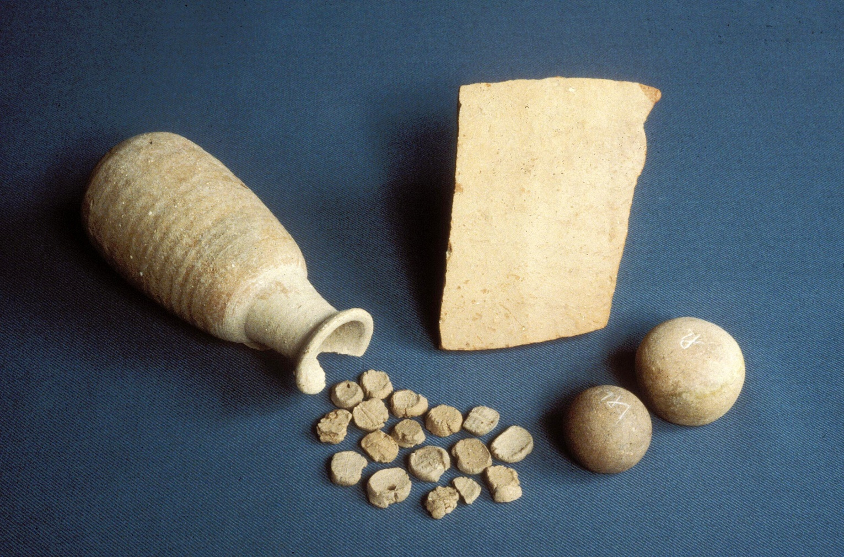
Lachish
17 seal impressions on bullae

Slide 18
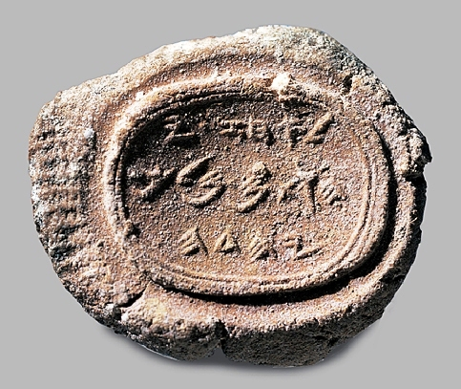
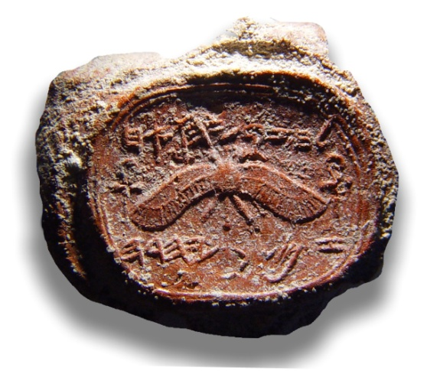
The Royal Hebrew Epigraphic Evidence

Slide 19
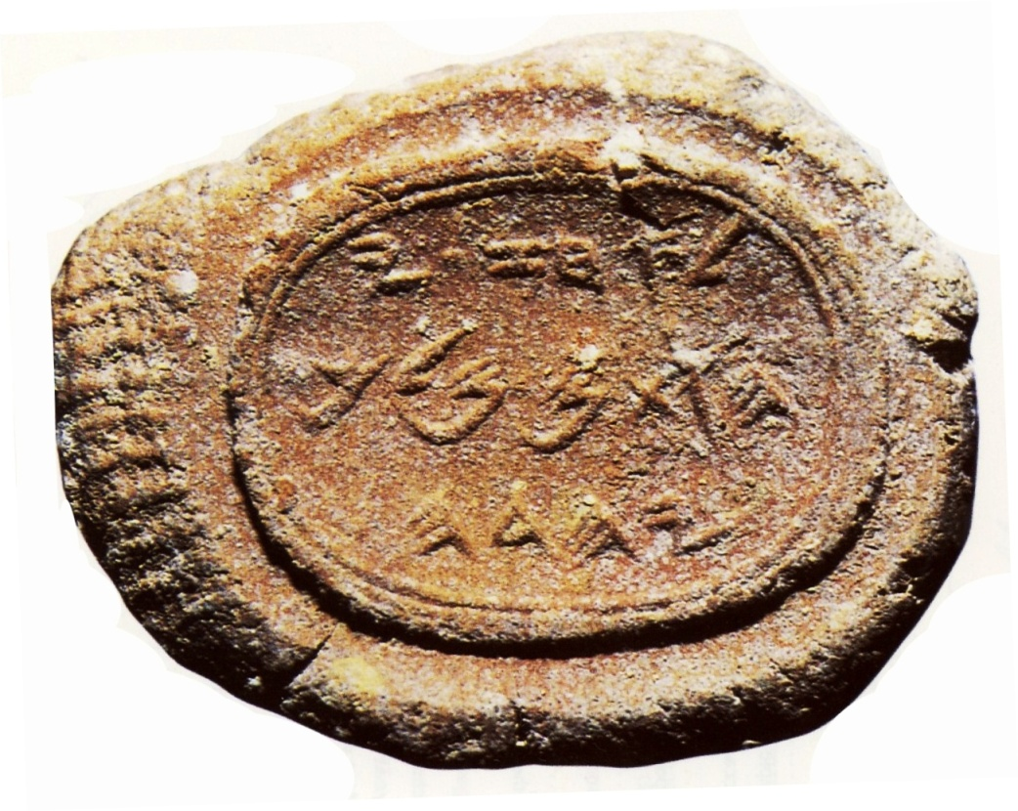
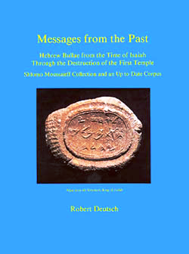
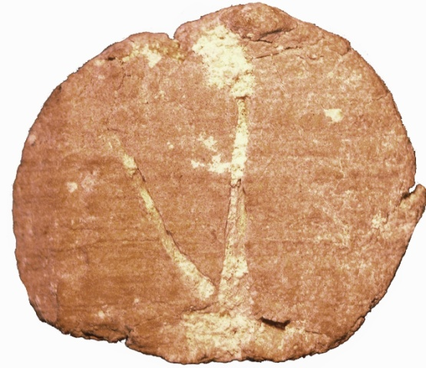
Clay Seal Impression (bulla), of
Ahaz, son of Yehotam, King of Judah (father of Hezekiah)
732 – 715 BC
Moussaieff collection
Notes:
The unique bulla of Ahaz known to date

Slide 20
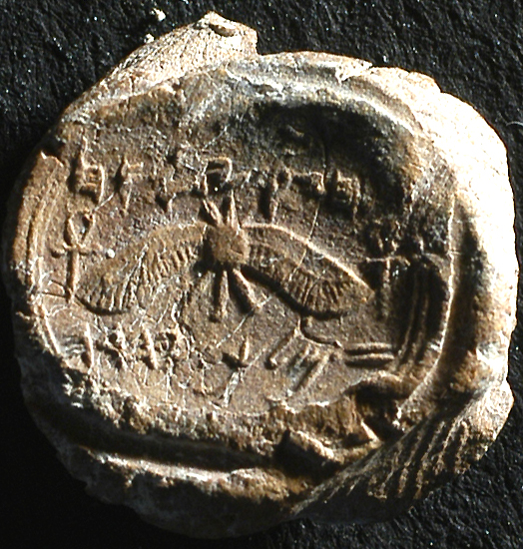
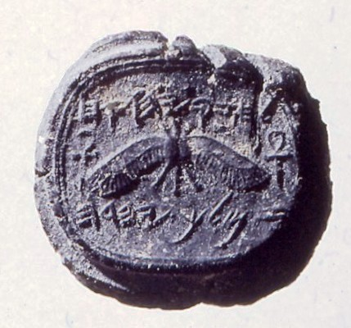
The Royal Bulla from Jerusalem Hezekiah, son of Ahaz, king of Judah
Notes:
Several such bullae of Hezekiah with unknown provenance were previously published
12 years later, an identical seal impression has been discovered
in the Jerusalem, in the City of David excavations
all impressed by the same seal.

Slide 21
Clay Seal Impressions (bullae), of
Hezekiah, King of Judah 715 – 686 BCE
impressed by 3 different seals
Jerusalem
BAR 2002
Notes:
Those are the 3 different seal impression of Hezekiah king of Judah,
one with the winged sun disk flanked by 2 “Ankhs”, the key of life emblems
and two similar, but not exact, with winged scarabs.
Clearly, the Egyptian influence is evident.

Slide 22
Royal bulla and seal impressions on storage jar handles
Notes:
The royal winged sun disc appears on both the lmlk jar handles and the royal bulla

Slide 23
Royal bullae and seal impressions on storage jar handles
Notes:
The royal (4 and 2) winged scarab appears on both the lmlk jar handles and on the royal bulla

Slide 24
Hezekiah, king of Judah
Notes:
The similar Egyptian iconography is found on both, the royal seals and on the LMLK jar handles

Slide 25
ROYAL
BULLAE
Market
Kaufman coll. no. 1
Zev Radovan
Moussaieff coll. Fest no. 1
City of David
Israel Museum
Market
K 509
Sasson coll.
Market
Brooklyn
Bible Museum
Market
Market
Market
Market
Moussaieff coll. Fest no. 2
Kaufman coll. no. 3b
Kaufman coll. no. 3a
Notes:
The first recorded royal bulla has been published by Nahman Avigad in 1986 from Sasson collection
Today are known 20 Royal seal impression of Hezekiah:
8 bullae depicting the winged sun disk, impressed by the same seal
and 12 bullae depicting a 4 winged scarab, impressed by 2 different seals

Slide 26
Seals of “Servants” (High Officials) at the Court of Hezekiah King of Judah
Notes:
In addition to the royal seals, we find bullae belonging to high officials mentioning their titles:
“Servants of Hezekiah”, probably a higher status than just “Servants of the King”.

Slide 27
1 2
Jeremiah the Secretary
servant of Ahaz (king of Judah)
Kaufman collection
The commander of the army,
servant of Hoshea (king of Israel)
Kaufman collection
Notes:
Two exceptional bullae mentioning the name of the kings, have two titles:
No. 1 is “The servant of king Ahaz (of Judah)”, the father of Hezekiah, as also the “Secretary”,
And no 2 is “The commander of the Army”, and “The servant of Hoshea” (the king of Israel” !!

Slide 28
High officials
Notes:
Complementing the OT narrative
From top left clockwise:
“Ma’aseyahu the Judge” “Hagab the Minister of the City”
“Azaryahu the Gate Guardian of the Jail” “The Minister of the City”
with Assyrian iconography)

Slide 29
1 2 3 4 5 6 7 8 9 10 20 30
Notes:
The term FISCAL BULLAE are given to bullae used in Judah in the time of Hezekiah,
probably from 701 BCE, after the Assyrian conquest, in order to collect the taxes

Slide 30
1 2 3 4 5 6 7 8 9 10 20 30
Notes:
The fiscal bullae are written in ancient Hebrew
But the numerals are in Hieratic
The Hebrews did not developed a numeral system and they adopted the
Egyptian Hieratic system (another Egyptian influence)

Slide 31
בשבעת ב/ית לחם / (למל)ך (ב X שנה) / (אלת)קן / (ל)מלך
(IN THE … YEAR …, ELTE)QEN’ TO THE KING IN THE SEVENT, BEIT LEHEM, TO THE KING
Notes:
Two fragmentary fiscal bullae found in controlled excavations in Jerusalem

Slide 32
In the 19th year / Lachish / Belonging to the king
(Deutsch 2003, no. 53, Kaufman coll.)
Notes:
The majority of the fiscal bullae have 3 registers
The first register contains the date, the second one contains the name of a town
and the third register contains the ownership “Belonging to the King

Slide 33
van_der_veen@gmx.de
Fiscal Bullae
mentioning biblical towns
(ג)בען
(ב)ית לחם
קעלה
לכש
אלתלד
בתל
שוכה
גבעה
עדרם
גת
ארב
צאננם
(א)פקה
גבם
מען
ארבת
נצב
Notes:
The fact that all the fiscal bullae are mentioned in the OT
Proves the validity of the OT account as given in the book of Joshua.

Slide 34
Notes:
30 fiscal bullae are published to date and the corpus is expected to grow
to include ALL the biblical towns mentioned in the book of Joshua.

Slide 35
שוכה SOKHO
יהושע טו כ - זאת נחלת מטה בני-יהודה למשפחתם:
טו לה - ירמות ועדלם, שוכה ועזקה
טו מח - ובהר, שמיר ויתיר ושוכה
Joshua 15:20 – This is the inheritance of the tribe of the children of Yehuda …
15:35 – Yarmut and Adullam Sokho Azeqa
15:48 – and in the mountains, Shamir and Yattir and Sokho
Notes:
The town of Socho is found, as expected, on Fiscal Bullae as also on the Fiscal LMLK jars

Slide 36
זיף ZIF
יהושע טו כ - זאת נחלת מטה בני-יהודה למשפחתם:
טו כד – זיף וטלם ובעלות
טו נה – מעון, כרמל וזיף ויוטה
Joshua 15:20 – This is the inheritance of the tribe of the children of Yehuda 15:24 – Zif and Telem and Bealot
15:55 – Maon, Karmel and Zif and Yuta
Notes:
The town of Zif is found on Fiscal Bullae as also on the Fiscal LMLK jars

Slide 37
ממשת זיף שוכה חברון

Slide 38
ממשת זיף שוכה חברון
Notes:
The two remaining name, MMShT and Hebron, which appear on the jars,
are also expected to be discovered on fiscal bullae

Slide 39
בשלשת
למכס
Notes:
A unique fiscal bulla is dated to the third (year),
and mentions that it belongs to the Custom
No town’s name and no royal ownership are mentioned
I will call this type of bullae “A Minimalistic Fiscal Bulla”

Slide 40
Avigad 1986 Avigad & Sass 1997
255 bullae (44 duplicates) 1194 seals, seal impressions
Notes:
The corpus of seals and seal impressions up to date is over 2,500
and the number is constantly growing.

Slide 41
City of David excavations 1982
45 bullae
Notes:
Bullae and seals are a first-hand find that supports and confirms the biblical story of the period

Slide 42
Joseph Chaim Kaufman collection First Vol. 2003 Second Vol. 2011
516 bullae (95 duplicates) 87 seals & 241 bullae (12 duplicates)
Notes:
The material with unknown provenance in private collections are of high importance,
as more materials recovered in control excavations turns out to be
duplicates of already published material.

Slide 43
Deutsch and Heltzer, 1994, 1995, 1997, 1999
42 bullae (+ 6 duplicates)

Slide 44
209 and 21 seals
Deutsch and Lemaire 1999 & 2003
Notes:
Thank you for your attention

